Slide 1
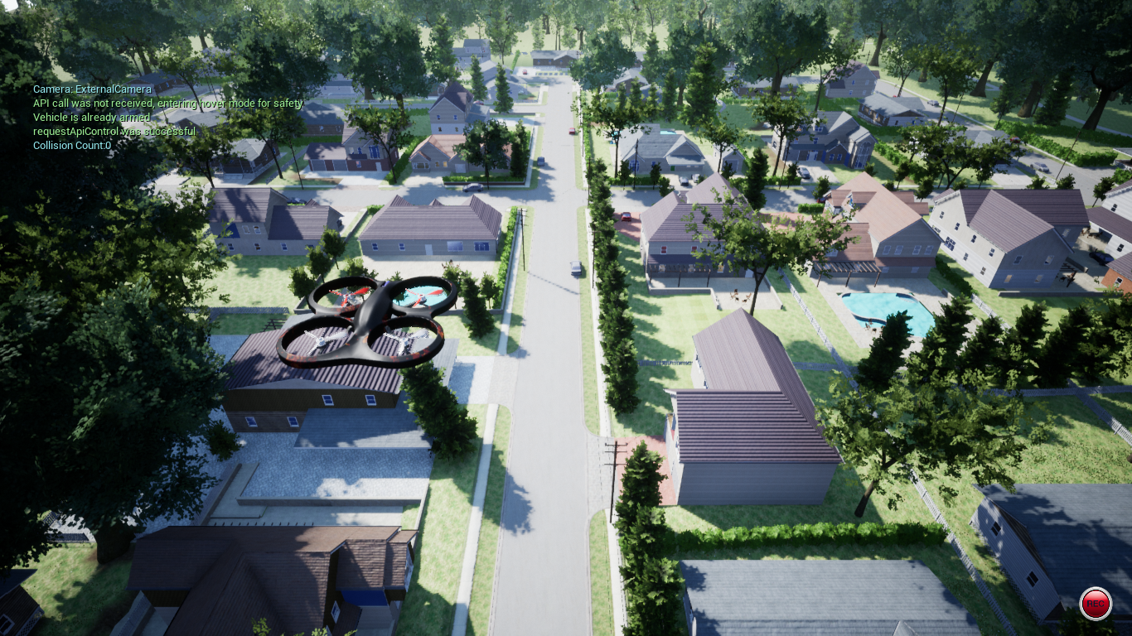


A machine learning approach for UAV–based ground target geolocation in aerial images
by
Anurag Paul
20EC01045
Under the supervision of Dr. Niladri Bihari Puhan

Slide 2
Contents
Introduction
Analyse the run time of the encoder and decoder in terms of symbol operations.
Methodology
Results
Future Work
References
3
5
7
9
10

Slide 3
Introduction
Quadcopter aircrafts are widely used in security, rescue, plant protection, transportation, and other fields.
Real flight issues: assembly, maintenance, battery and so on.
These factors affect flight efficiency and extremely extend the development cycle. Therefore, simulation environments for the quadcopter test is used.
Simulation platforms: Gazebo [1] [figure 1], jMavSim [2] [figure 2] and so on.
Gazebo is widely used in the robots, cars, and drone simulation.

Slide 4
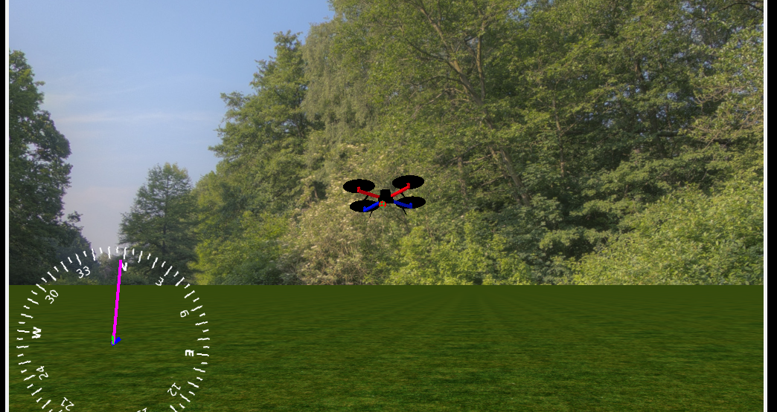
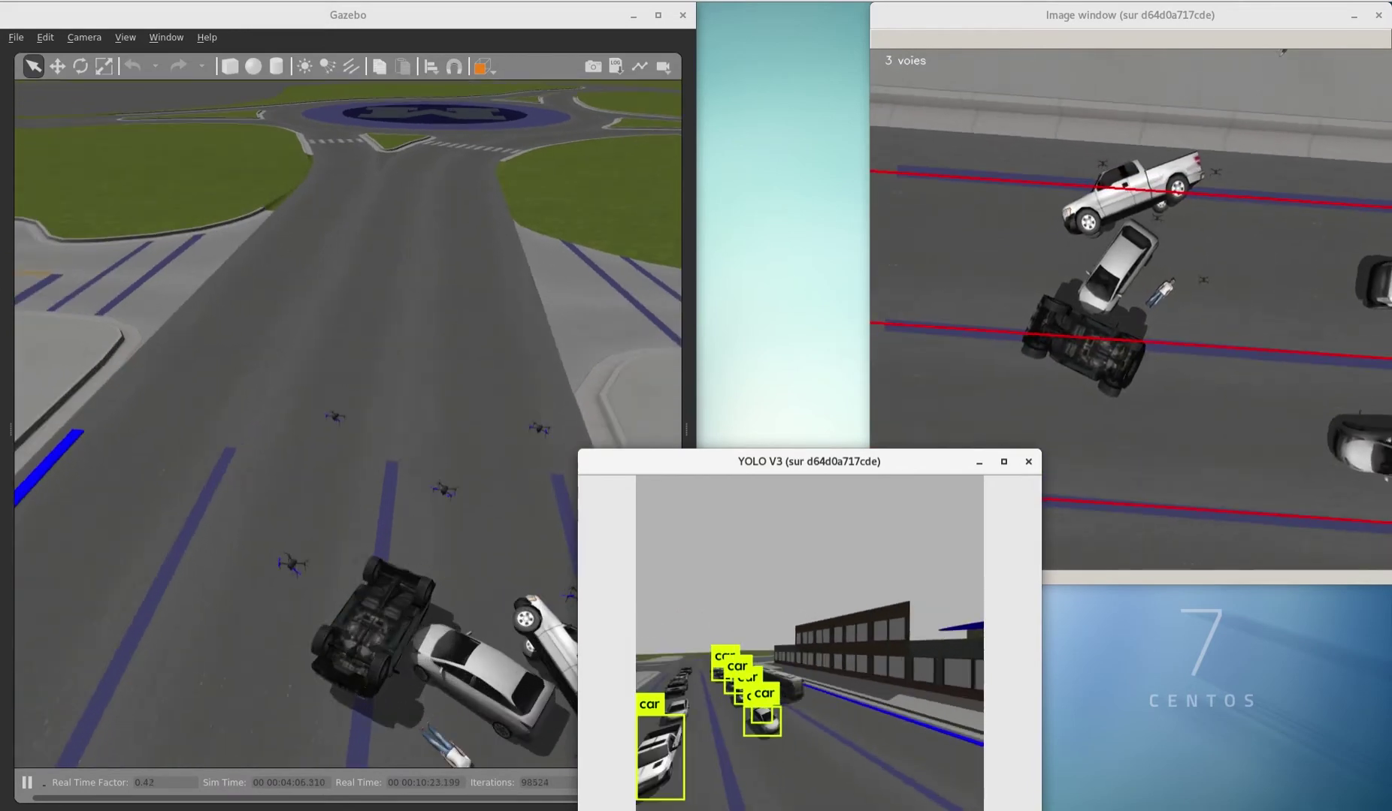
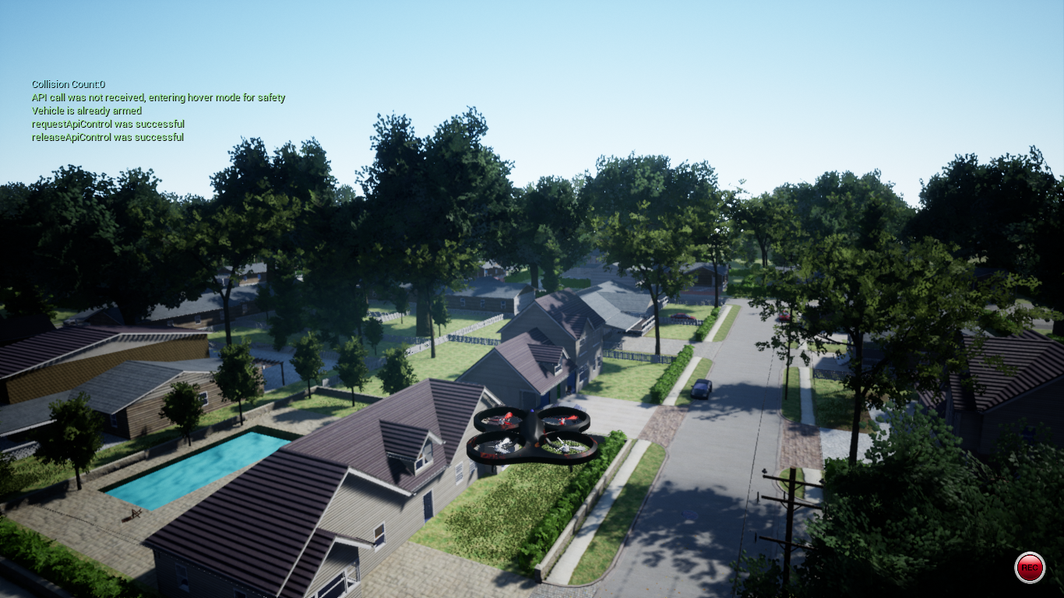
Figure 2: jMavSim, a simple multirotor simulator with MAVLink protocol support.
Figure 1: Gazebo drone fleet simulation.
Figure 3: AirSimNH environment.

Slide 5
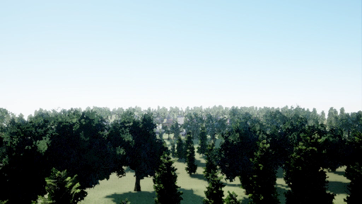

Slide 6
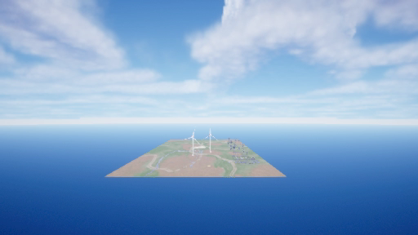

Slide 7
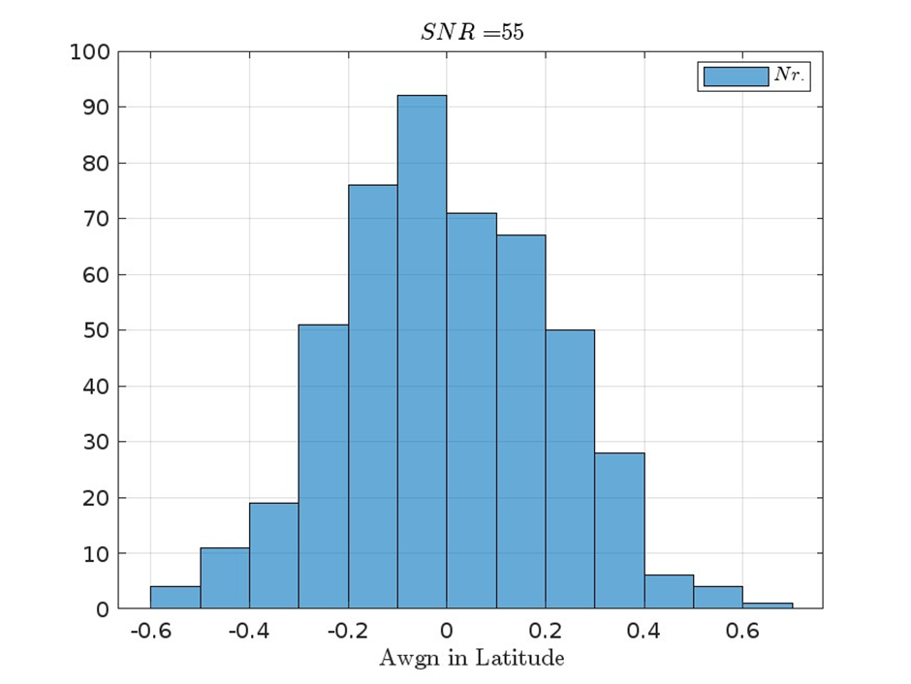
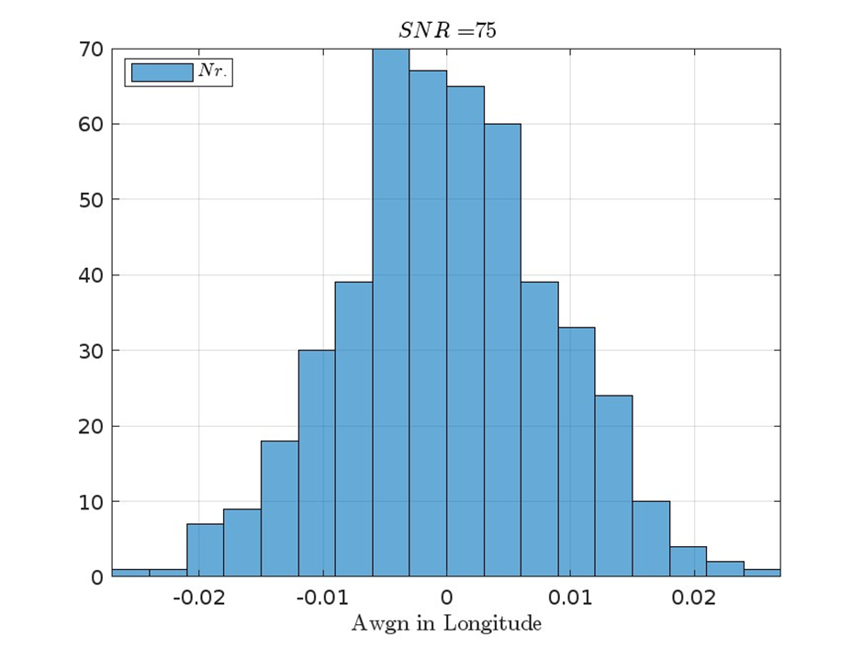
Methodology

Slide 8
Altitude | Longitude | Latitude | PixelX | PixelY | YLatitude
123.7985229 | -122.140125 | 47.6419267 | 256 | 144 | 47.6419267
174.5480347 | -122.140165 | 47.6419267 | 257 | 167 | 47.6419267
174.8162537 | -122.140165 | 47.6419267 | 257 | 168 | 47.6419267
176.4992676 | -122.140165 | 47.6419267 | 257 | 169 | 47.6419267
177.9062653 | -122.140165 | 47.6419267 | 257 | 169 | 47.6419267
178.6100311 | -122.140165 | 47.6419267 | 257 | 171 | 47.6419267
180.3651276 | -122.140165 | 47.6419267 | 257 | 171 | 47.6419267
181.2619781 | -122.140165 | 47.6419267 | 257 | 171 | 47.6419267
182.8026276 | -122.140165 | 47.6419267 | 257 | 173 | 47.6419267
184.0067596 | -122.140165 | 47.6419267 | 257 | 173 | 47.6419267
185.7004089 | -122.140165 | 47.6419267 | 257 | 174 | 47.6419267
186.8738556 | -122.140165 | 47.6419267 | 257 | 176 | 47.6419267
187.9985809 | -122.140165 | 47.6419267 | 257 | 176 | 47.6419267
189.4416962 | -122.140165 | 47.6419267 | 257 | 177 | 47.6419267
190.2579041 | -122.140165 | 47.6419267 | 257 | 177 | 47.6419267
191.8865051 | -122.140165 | 47.6419267 | 257 | 177 | 47.6419267
193.0978851 | -122.140165 | 47.6419267 | 257 | 178 | 47.6419267

Slide 9
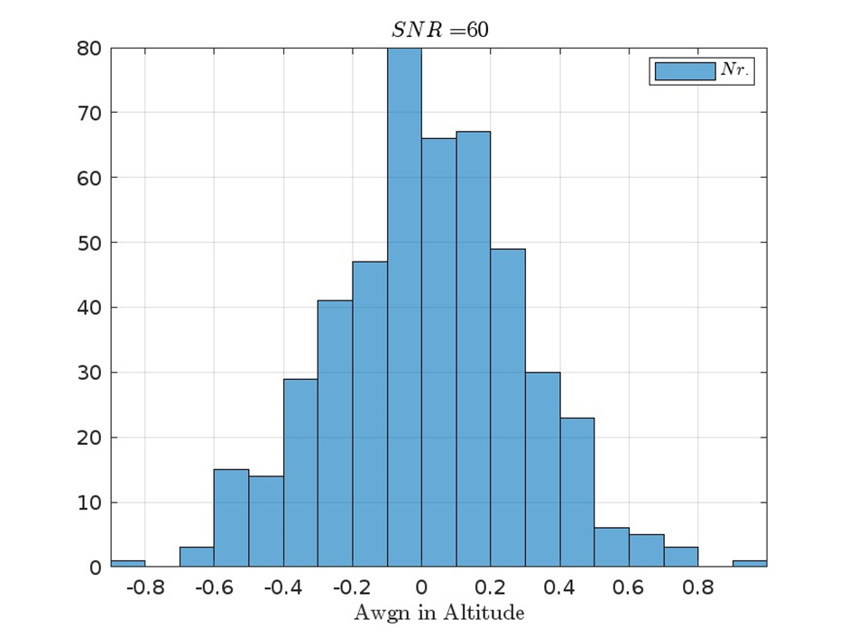
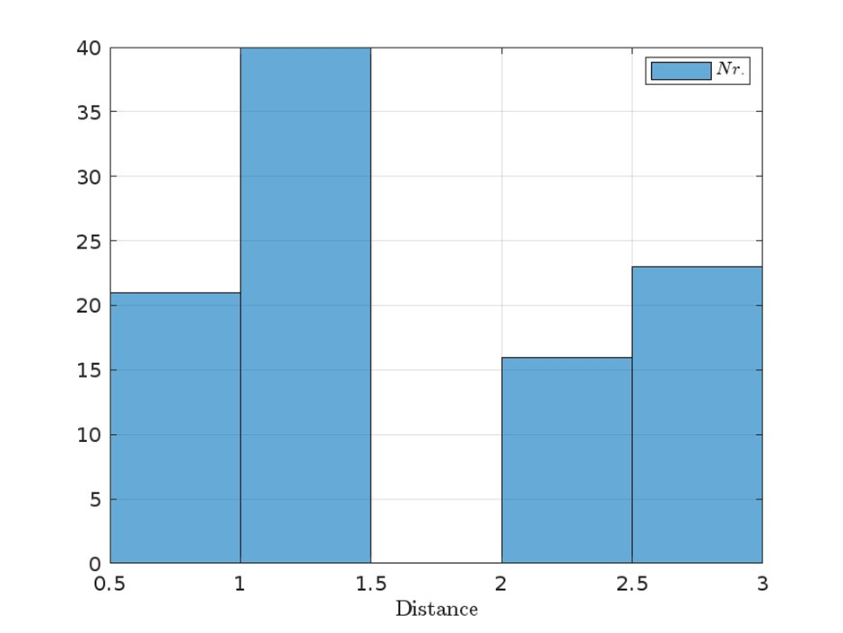
Haversine distance

Slide 10
Results
Sr. Nr. | Drone |  | Target |  | Distance
 | Latitude | Longitude | Latitude | Longitude
1 | 47.64192669 | -122.140165 | 47.64192669 | -122.1401251 | 1.91 nm
2 | 47.63749272 | -122.140165 | 47.64185602 | -122.1384163 | 3.88 nm
3 | 47.63749273 | -122.140165 | 47.64116615 | -122.1384163 | 9.94 nm
4 | 47.63749272 | -122.140165 | 47.641468 | -122.140165 | 7.07 Å
5 | 47.63749253 | -122.1401649 | 47.63749253 | -122.1401649 | 1.7 mm

Slide 11
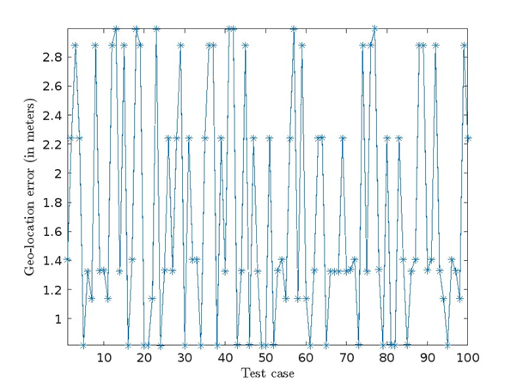
Results

Slide 12
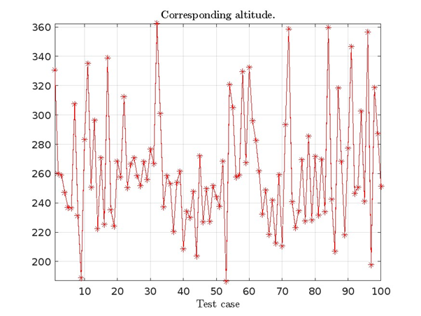
Results

Slide 13
Future Work
Some more sets of images, n target locations will be acquired for training, testing and validation.
Moving vehicle detecting, tracking, and geolocating.
Efficiency for small object detection in complex scenes.
Flight control method in terms of the previous image processing results to lead the UAV that is following the moving vehicle.
Optional parameters: Gimball's roll, pitch, yaw; Target altitude, TimeOfDay

Slide 14
References
N. Koenig and A. Howard, "Design and use paradigms for Gazebo, an open-source multi-robot simulator," 2004 IEEE/RSJ International Conference on Intelligent Robots and Systems (IROS) (IEEE Cat. No.04CH37566), Sendai, Japan, 2004, pp. 2149-2154 vol.3, doi: 10.1109/IROS.2004.1389727.
jMAVSim. url: https://github.com/DrTon/jMAVSim.
S. Shah, D. Dey, C. Lovett and A. Kapoor. “AirSim: high-fidelity visual and physical simulation for autonomous vehicles”. In: IEEE Transactions on Geoscience and Remote Sensing (2017), p. 14.

Slide 15


TH NK Y U

